Slide 1
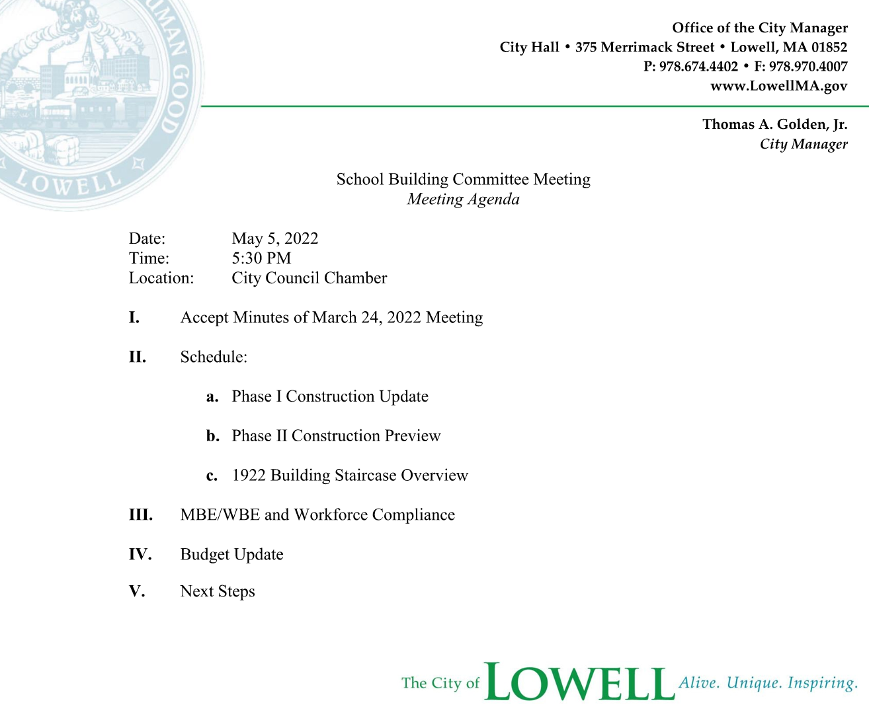
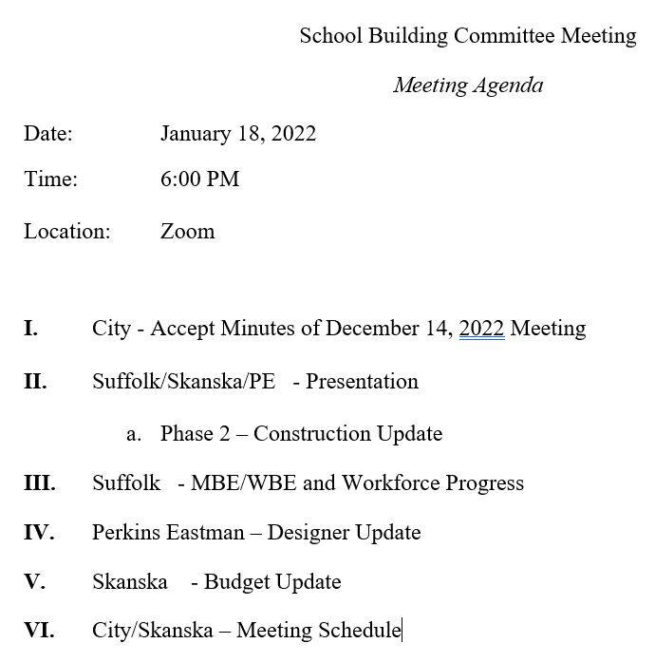

Slide 2
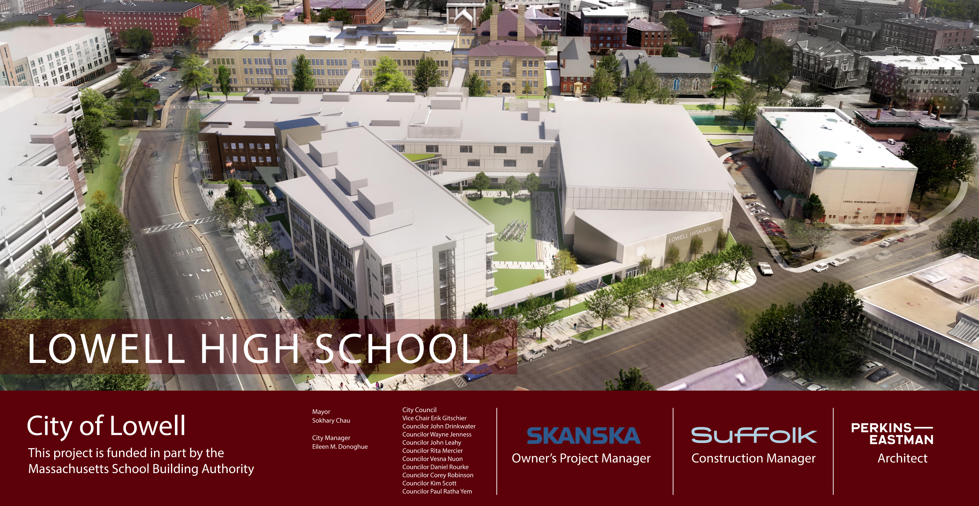

Project Overview
City Manager
Thomas A. Golden, Jr.

Slide 3
Phase 2 Construction Update

Slide 4
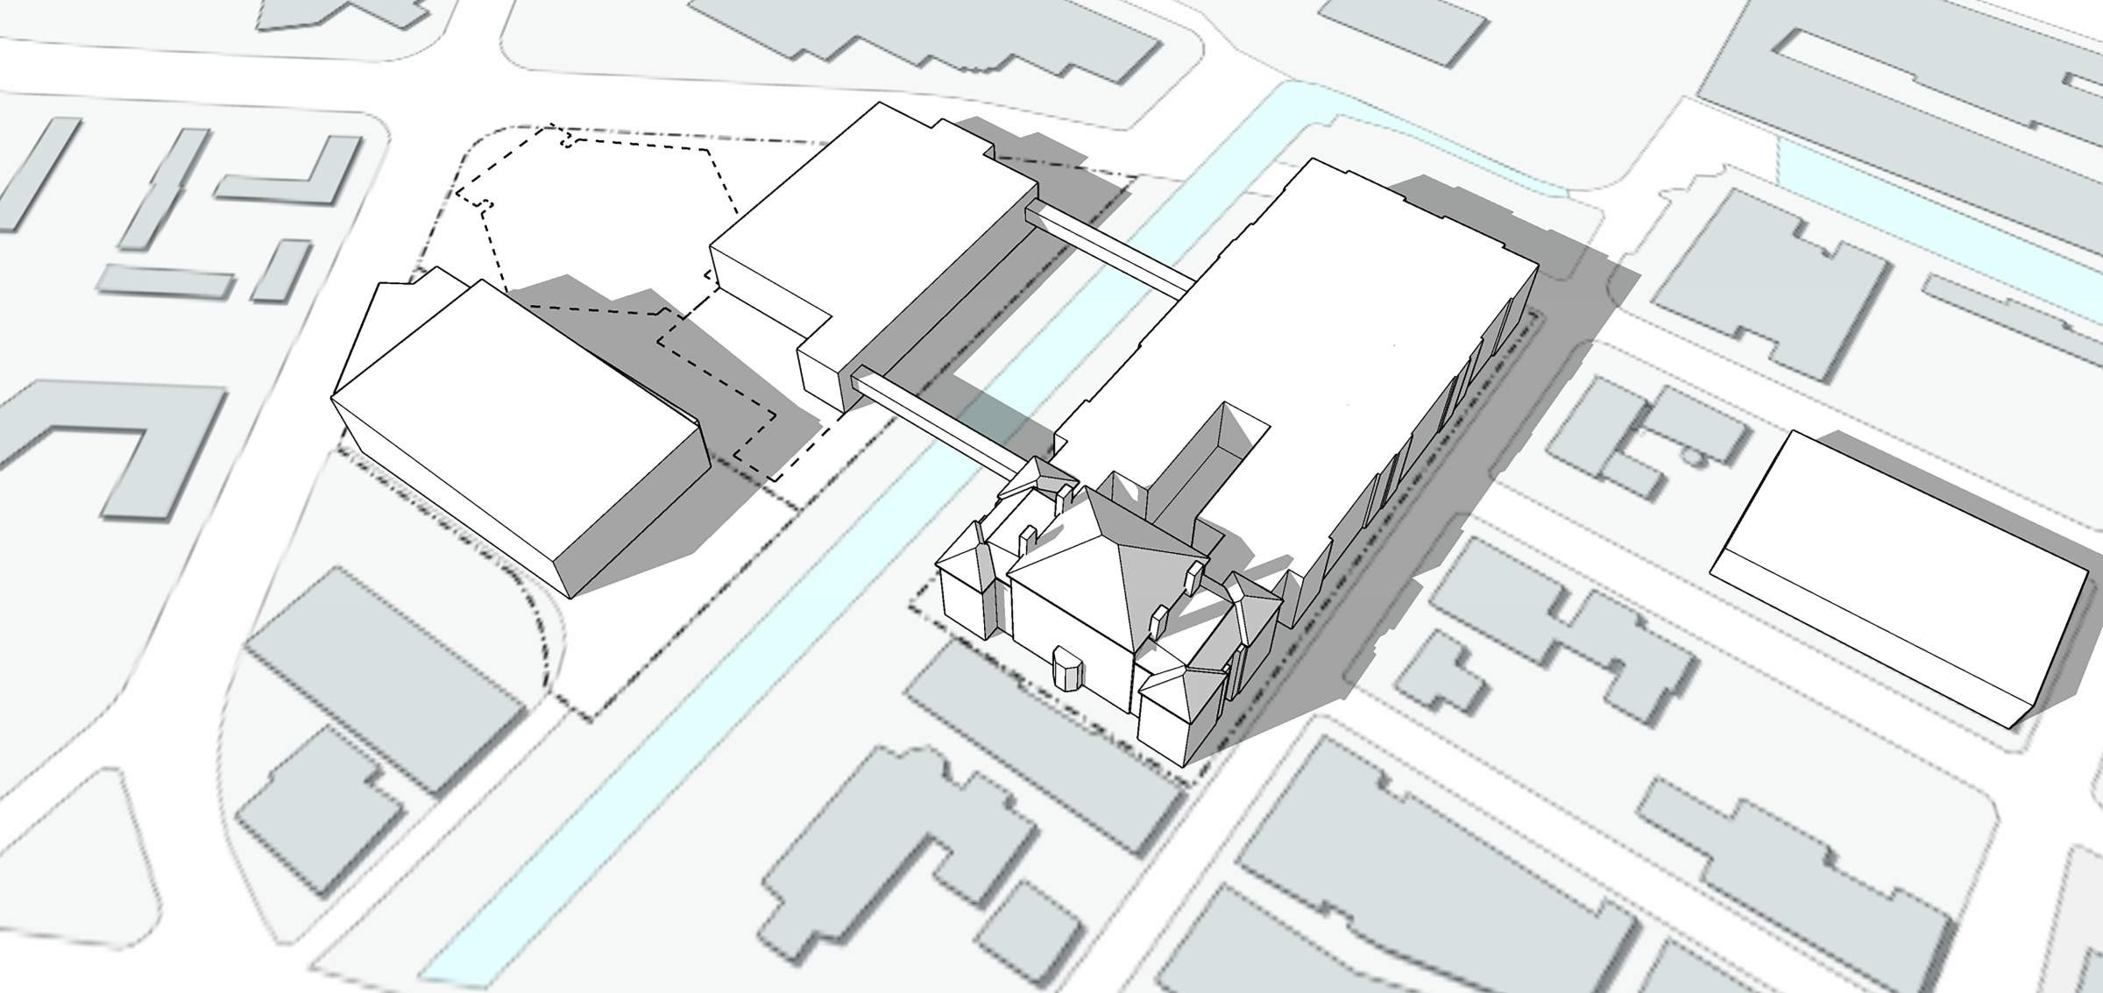

Phase 2 Milestones
^{F}ATHER MORISSETTE BLVD
DEMO EXISTING GYMNASIUM
    January 2023
    Begin Structural Steel
    Begin Underground MEPs
    Complete Concrete Foundations at F Building/NC
    Complete Micropiles at Bridge
CONSTRUCTION
FENCE
TEMPORARY
MAIN ENTRY
EXISTING 1980 BUILDING
EXISTING 1922 BUILDING
FRENCH STREET
    February 2023
    Continue Structural Steel
    Continue Concrete Foundations at D Building
COMPLETED NEW GYMNASIUM BUILDING
ARCAND DRIVE
DEMO S. BRIDGE
EXISTING FRESHMAN ACADEMY BUILDING
DEMO PORTION OF EXISTING 1980 BUILDING
PAIGE STREET
    March 2023
    Begin Concrete Slab Placements
KIRK STREET
CK CANAL
LEE STREET
IMA
_{R}R _{M}E

Slide 5
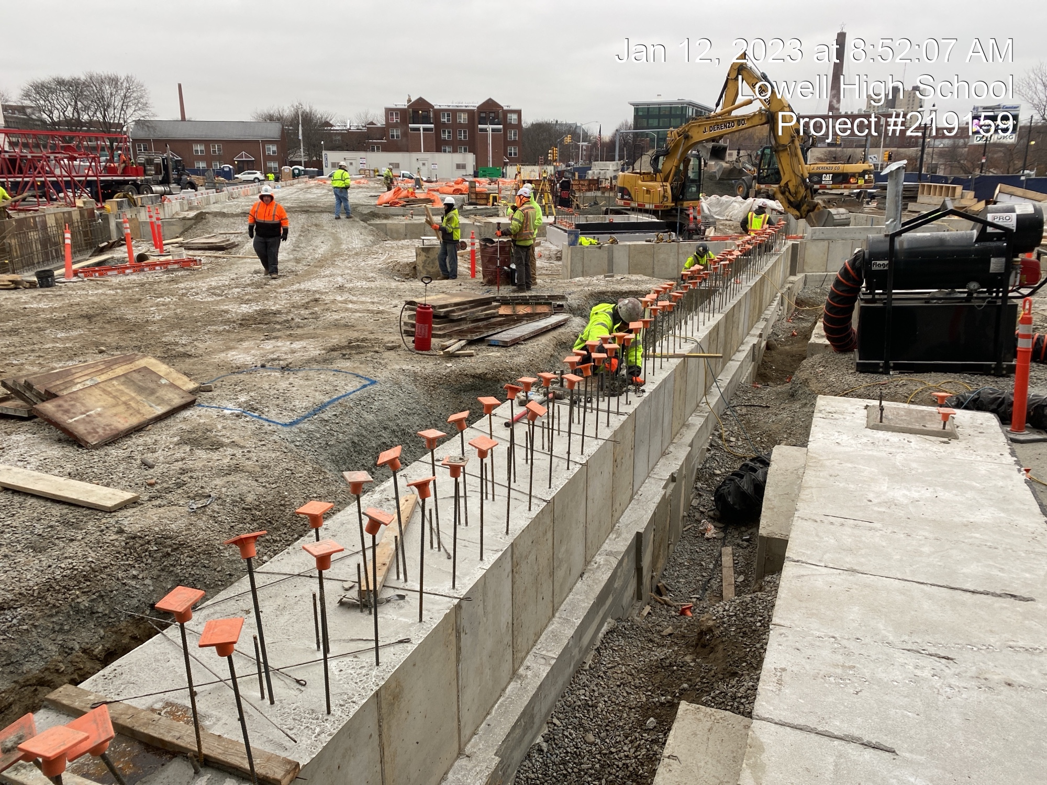
Foundation Walls (F Building & North Connector)

Slide 6
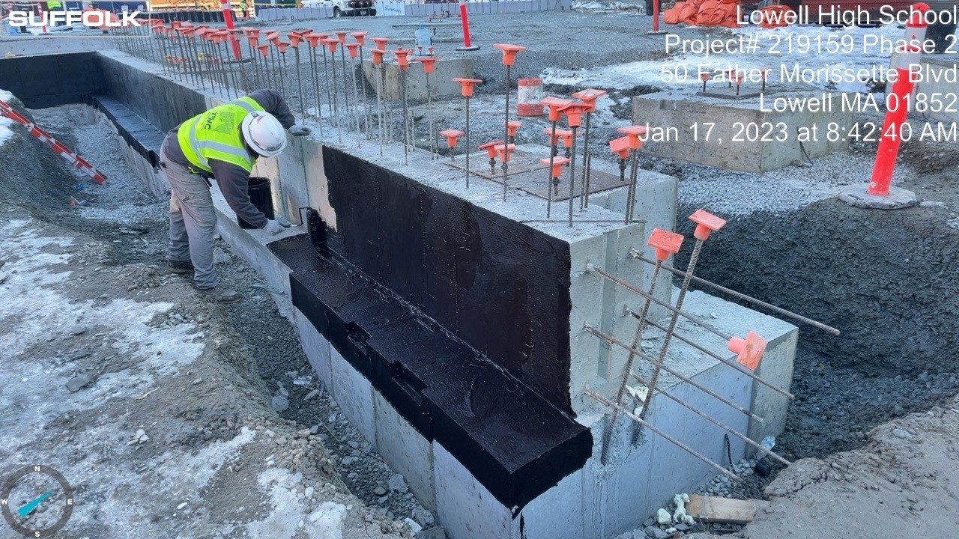
Foundation Walls & Dampproofing (F Building)

Slide 7
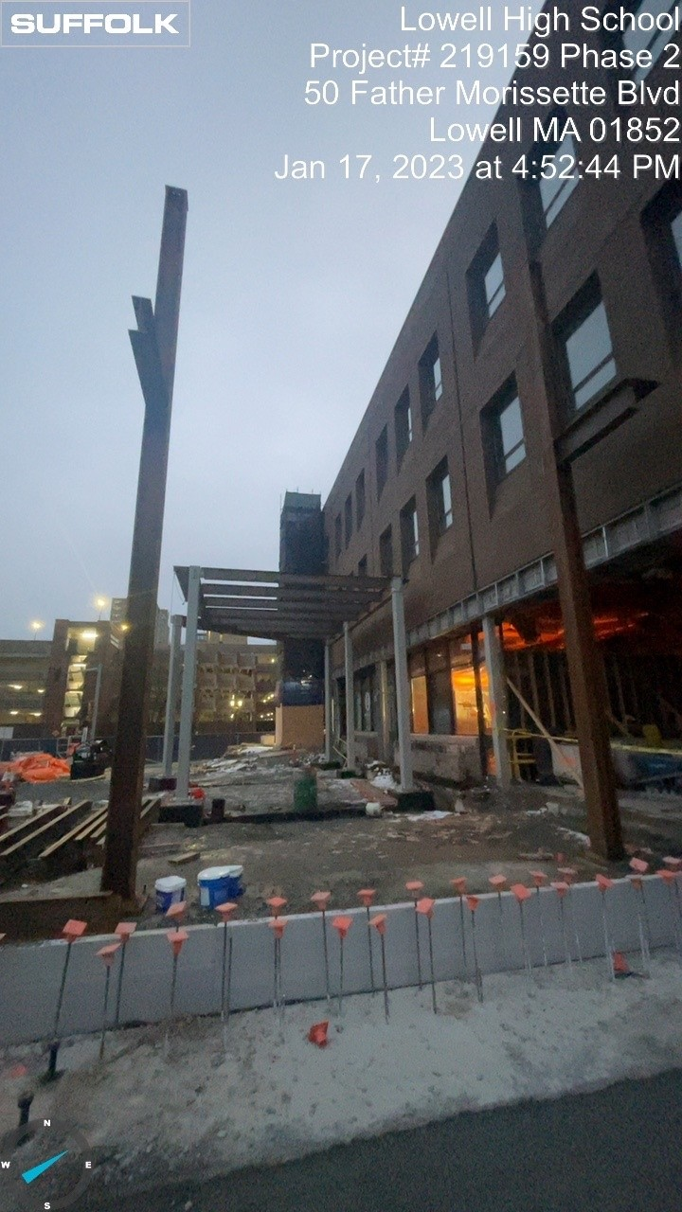
Steel Erection (North Connector)

Slide 8
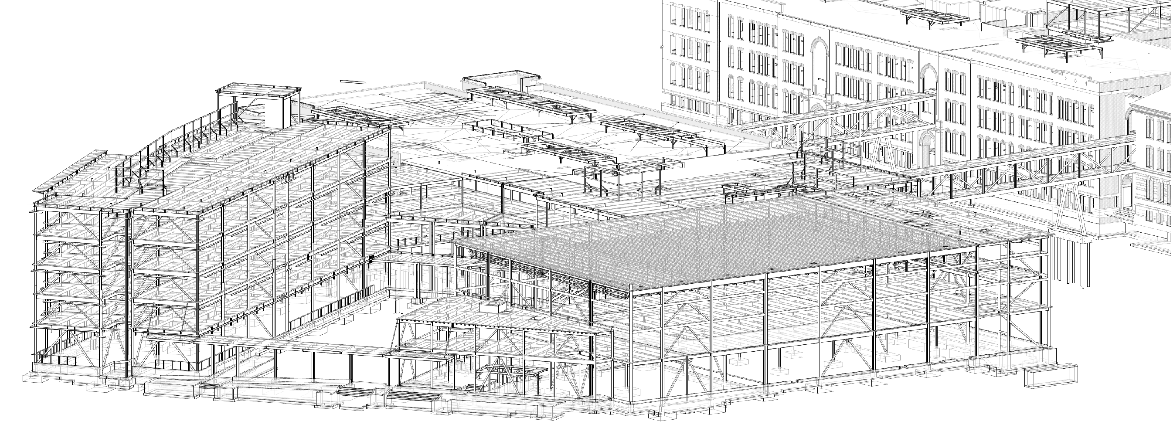
South Bridge
F Building
D Building
N. Connector
Canopy
Phase 2 Structural Steel
Locus Plan

Slide 9
Part 3: MBE/WBE and Workforce Progress

Slide 10
MBE/WBE and Workforce Participation Comparison*
Total Construction
Minority Workforce
is at 25.2% of workers
(387 workers & 49,510 hours)
Total MBE/WBE Contracts Awarded
$21,617,266
Total Construction
Female Workforce
is at 3.6% of all workers
(60 workers & 7,121 hours)
Total Construction Lowell Resident
10.8% of all workers
(87 workers & 21,198 hours)
* Updated December 9, 2022

Slide 11
Part 4: Designer Update

Slide 12
Part 5: Budget

Slide 13
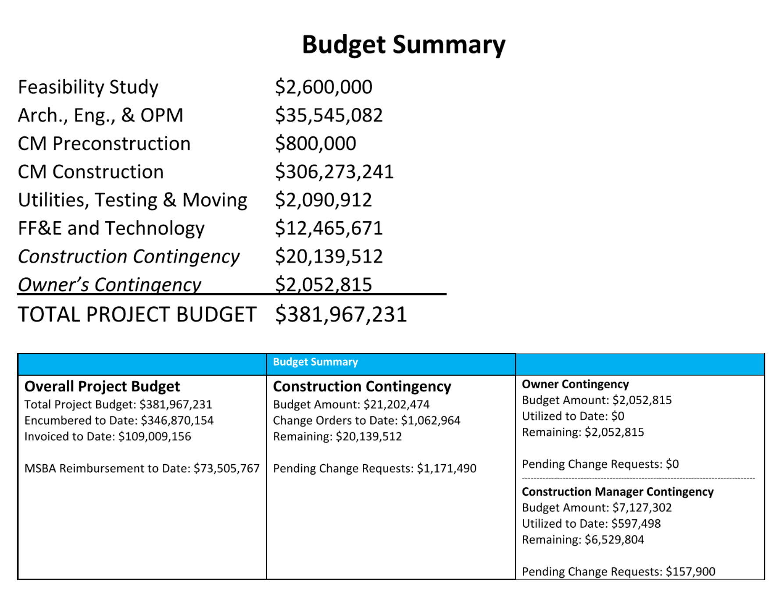

Slide 14
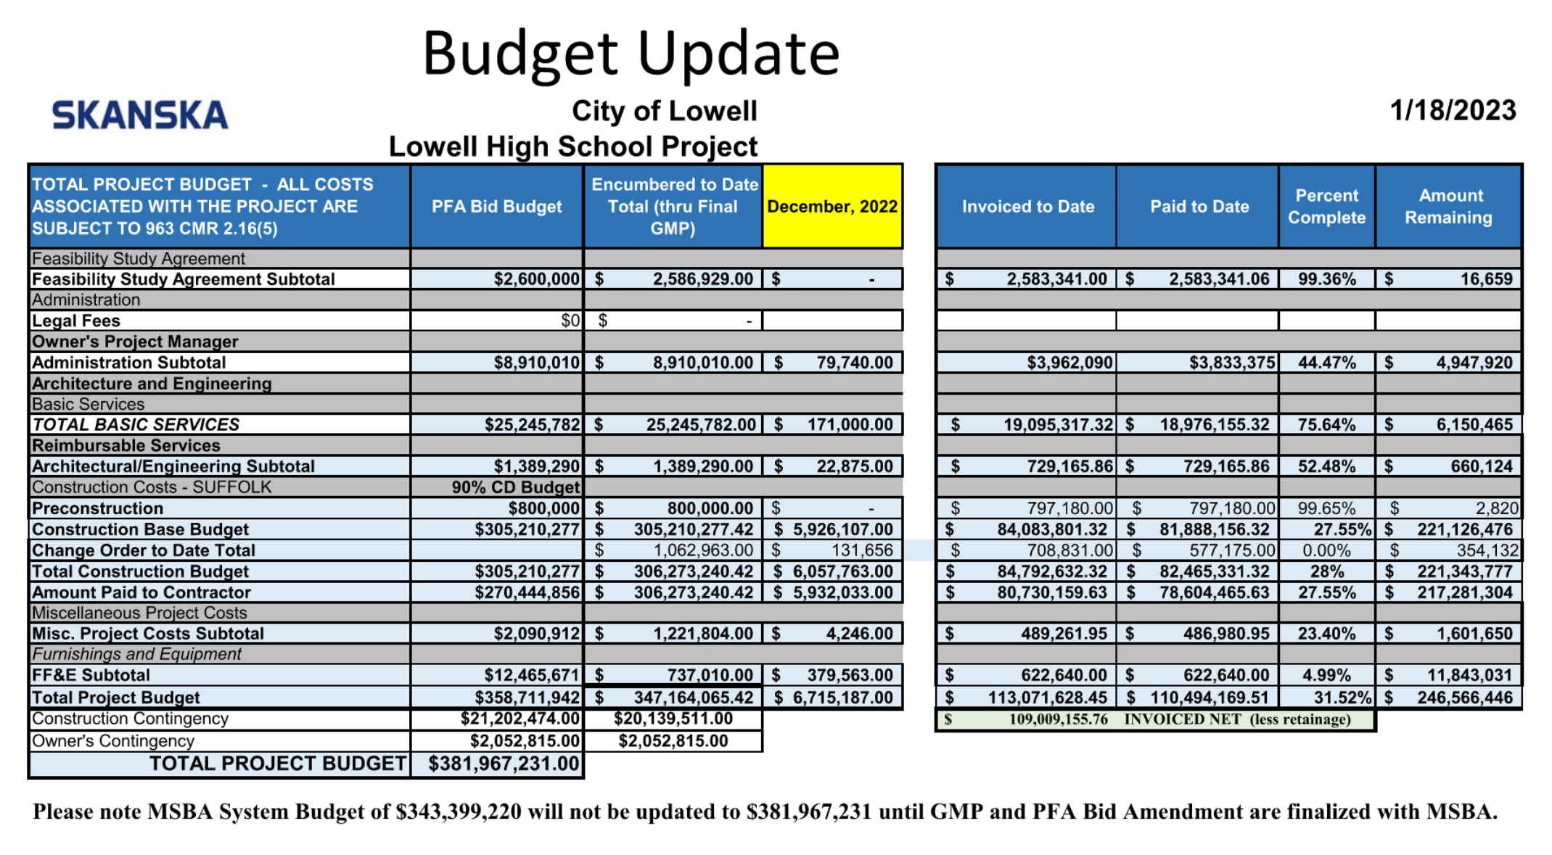

Slide 15
Part 6: Next Steps

Slide 16
Thank you

