Slide 1
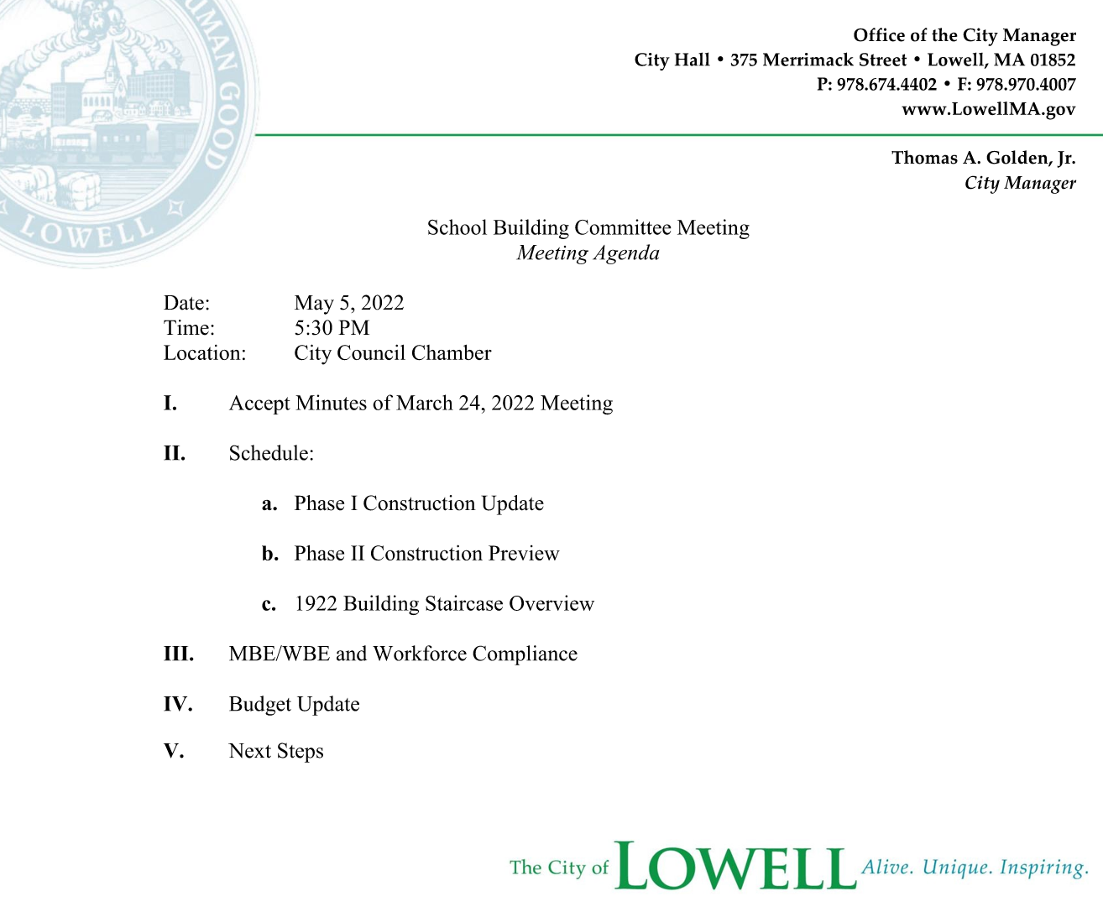
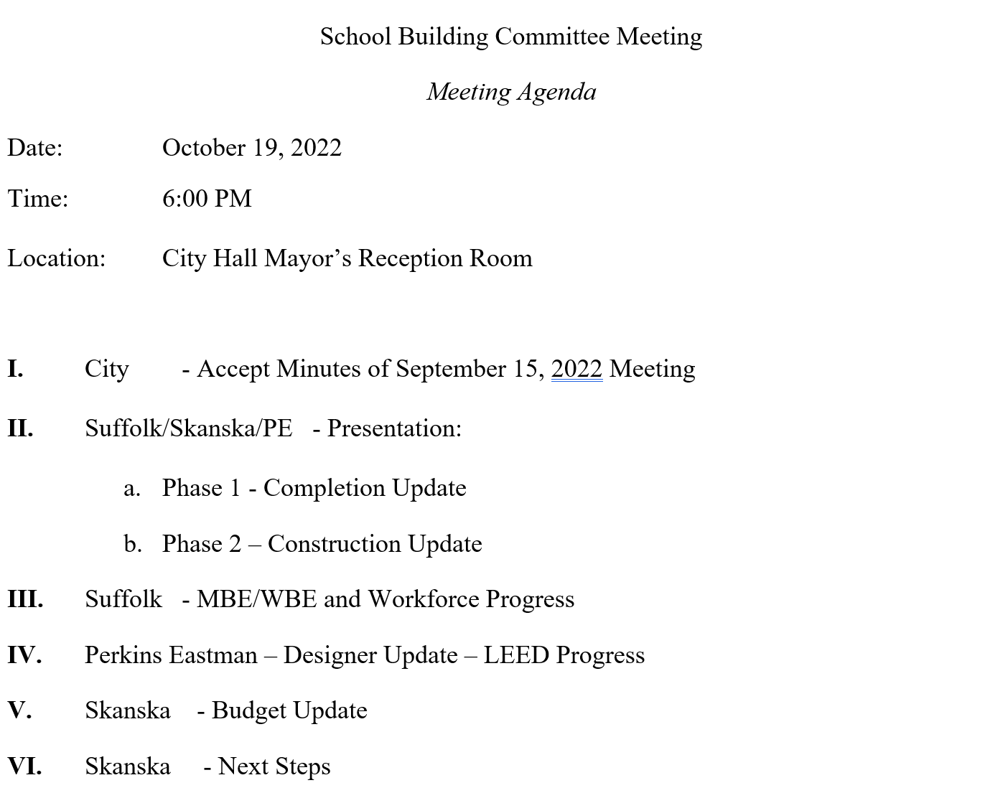

Slide 2
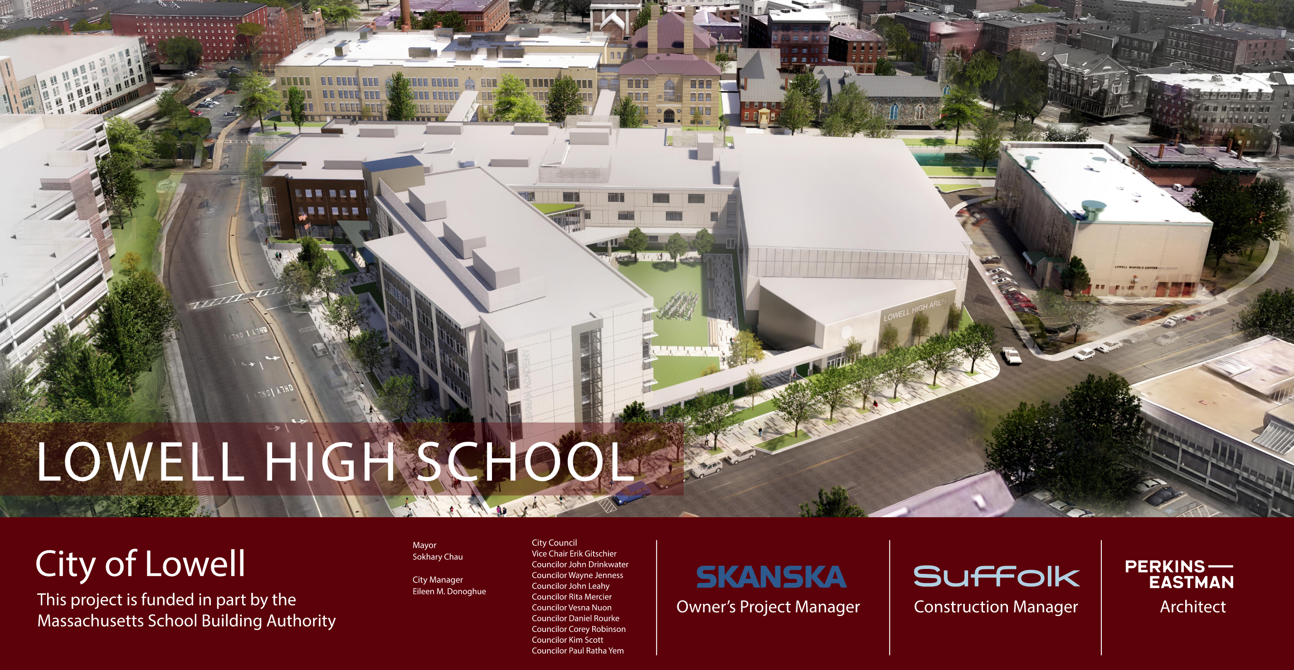

Project Overview
City Manager
Thomas A. Golden, Jr.

Slide 3
Construction Update

Slide 4
Phase 1 Construction Update

Slide 5
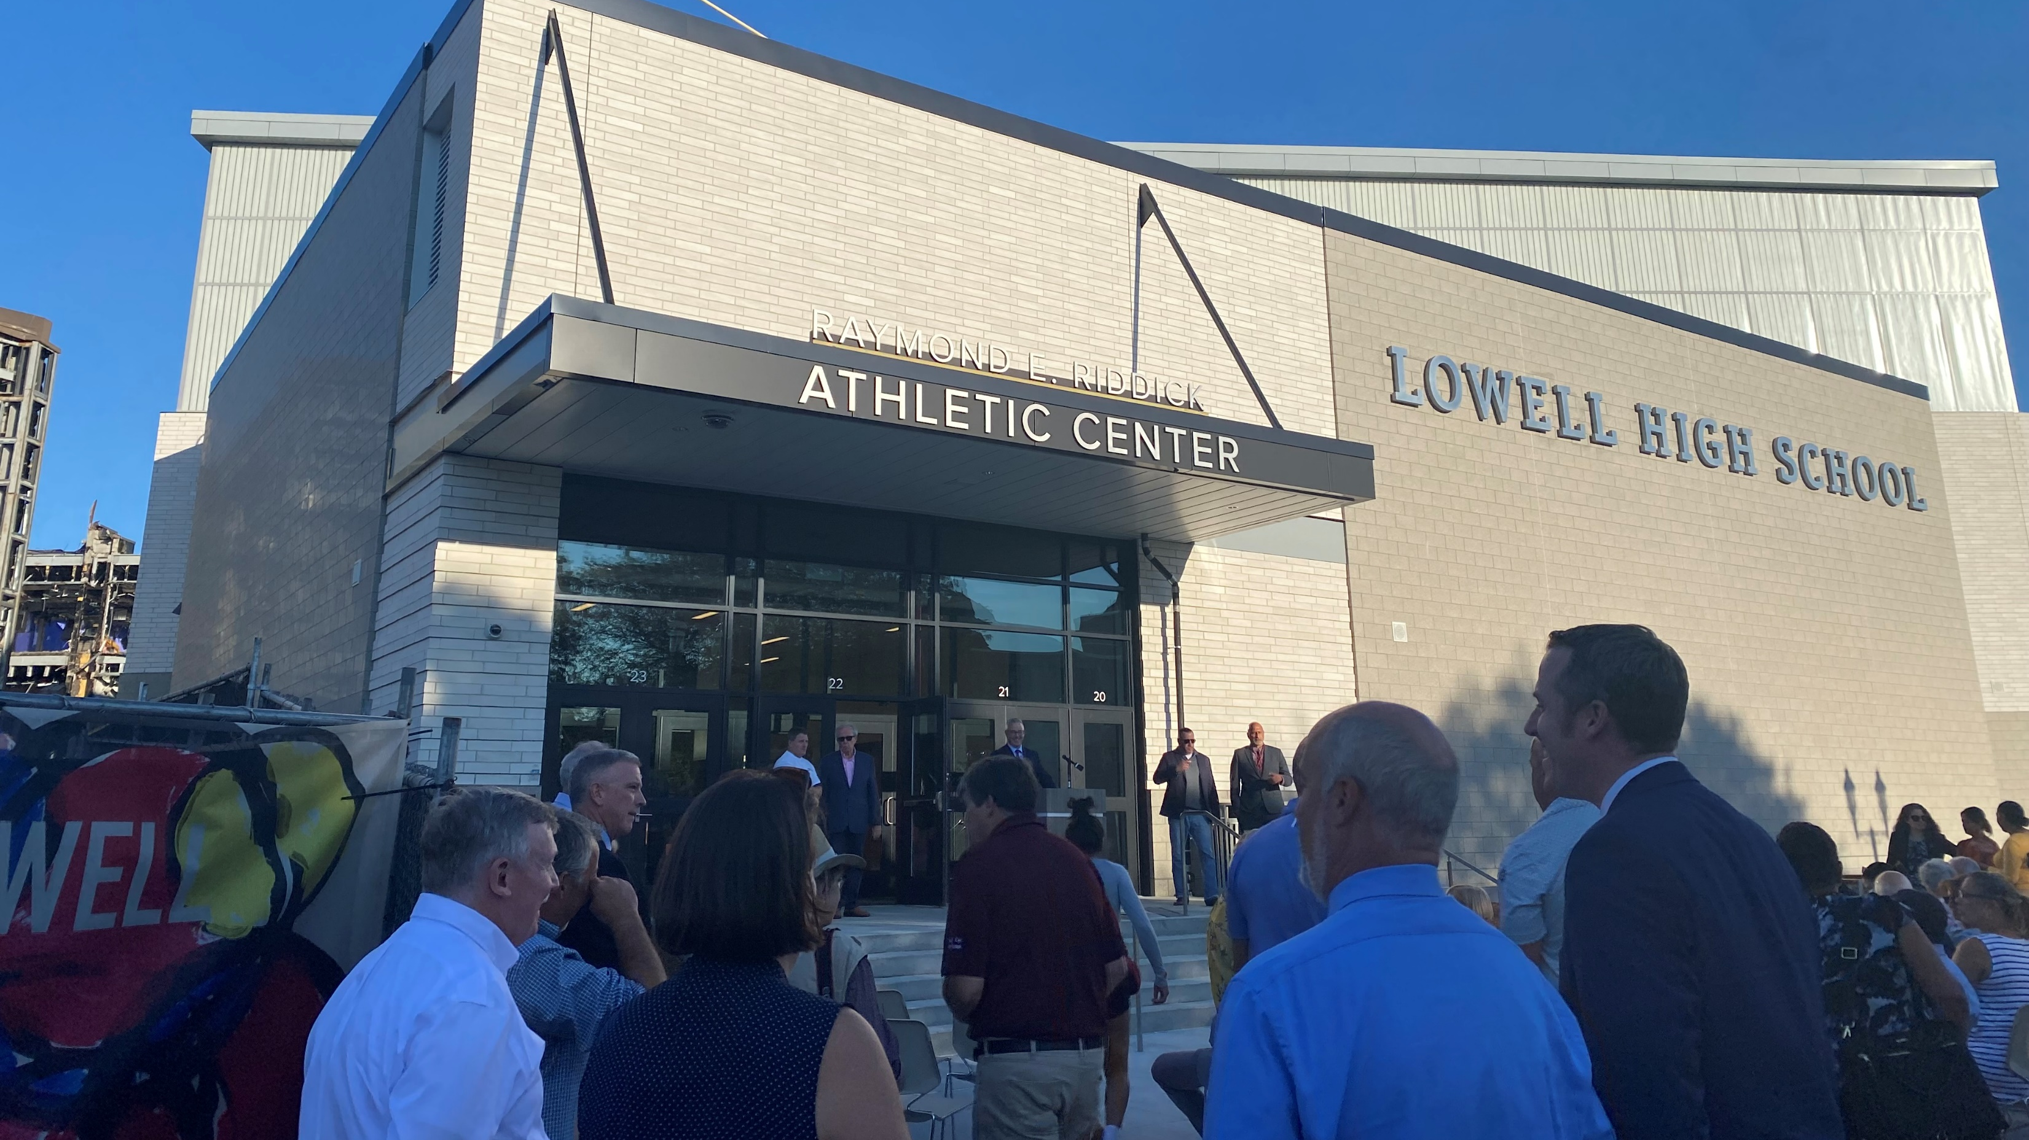
    Remaining Phase 1 Activities
    Place Loading Dock Concrete Pad
    Final Paving
    Fall Plantings
    Complete “Punchlist”, Training, Cx

Slide 6
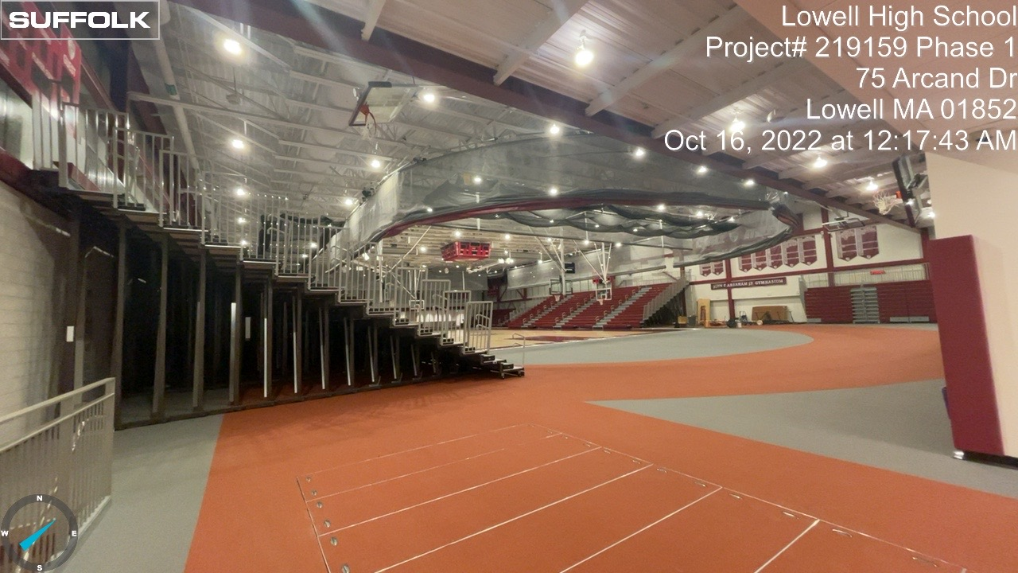
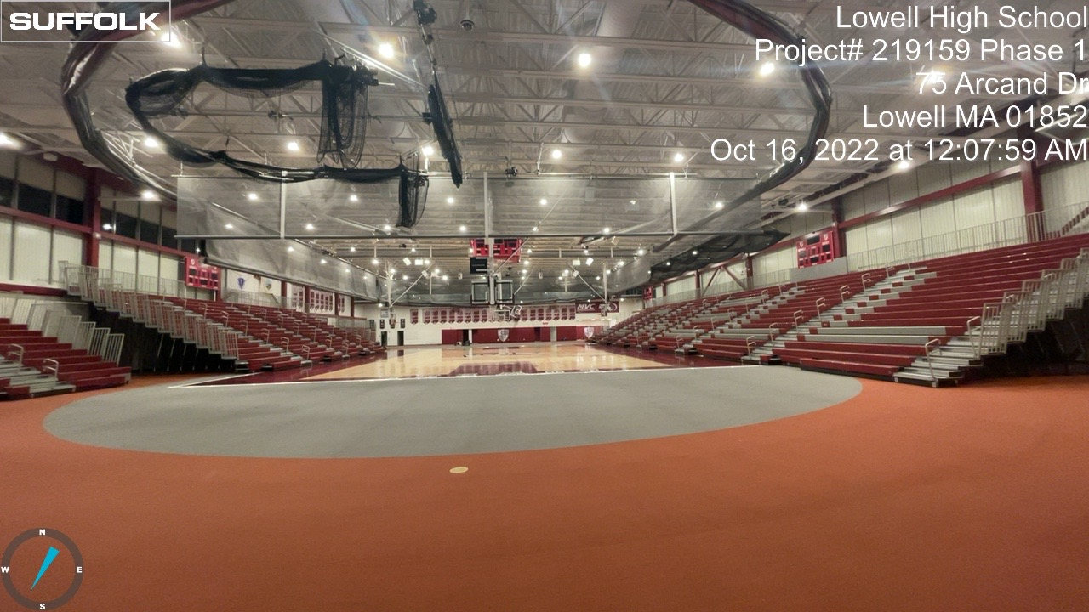
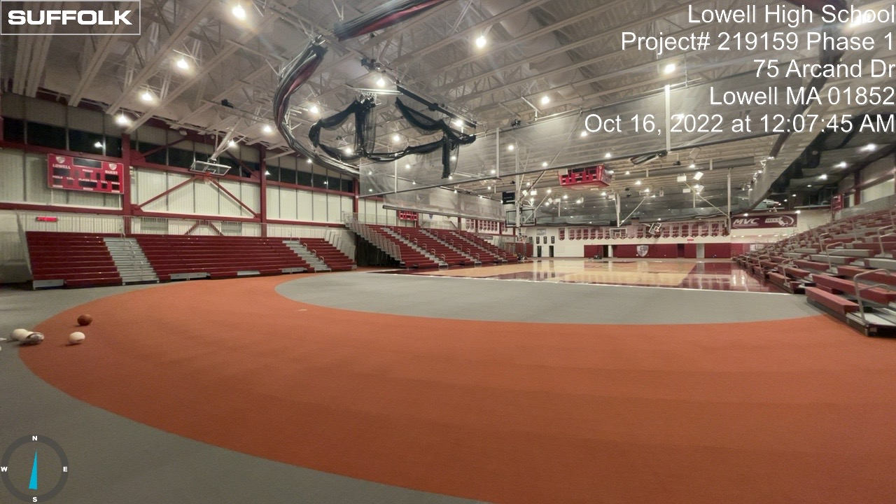
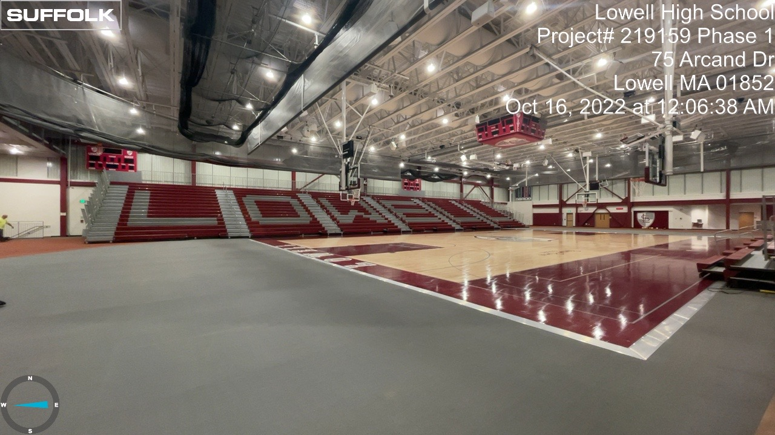
Bleacher Installation

Slide 7
Phase 2 Construction Update

Slide 8
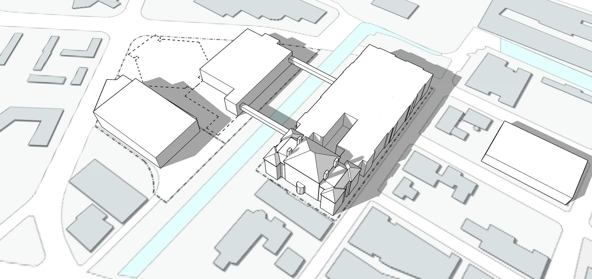

FALL ‘ 22
Phase 2 Milestones
    October 2022
    Complete Debris Load-out
    Mobilize Sitework Contractor
    Remove Part 2 South Bridge
    Begin Pre-excavation
^{F}ATHER MORISSETTE BLVD
DEMO EXISTING GYMNASIUM
CONSTRUCTION
FENCE
TEMPORARY
MAIN ENTRY
EXISTING 1980 BUILDING
    November 2022
    Begin Ground Improvements
    Mobilize Concrete Contractor
    Excavate Foundations
    Form & Pour Concrete Foundations
EXISTING 1922 BUILDING
FRENCH STREET
COMPLETED NEW GYMNASIUM BUILDING
ARCAND DRIVE
DEMO S. BRIDGE
EXISTING FRESHMAN ACADEMY BUILDING
DEMO PORTION OF EXISTING 1980 BUILDING
    December 2022
    Complete Ground Improvements
    Continue Concrete Foundations
    Begin Structural Steel Installation
PAIGE STREET
KIRK STREET
CK CANAL
LEE STREET
IMA
_{R}R _{M}E

Slide 9
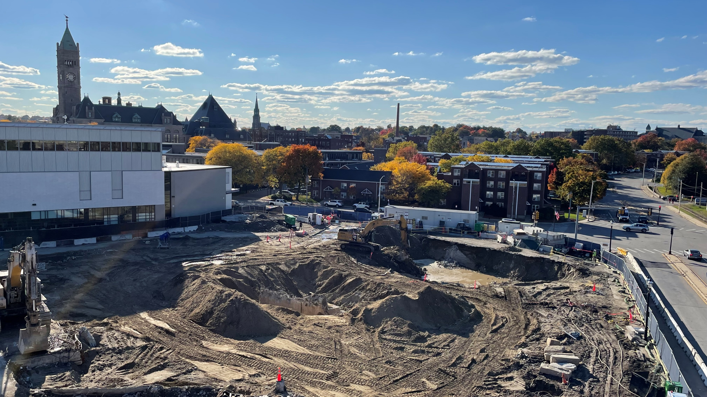
Phase 2 Limits of Work

Slide 10
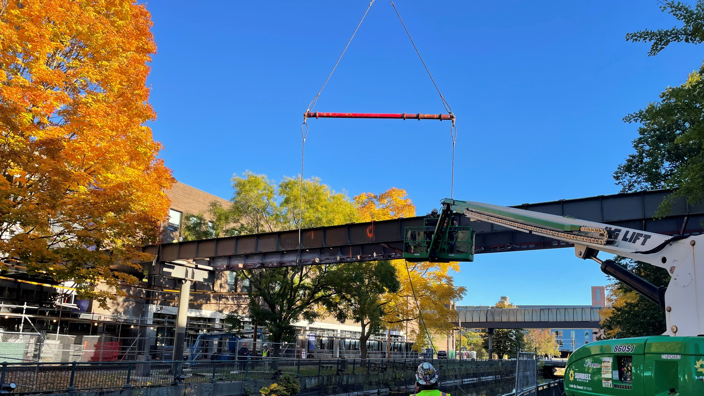
South Bridge Removal

Slide 11
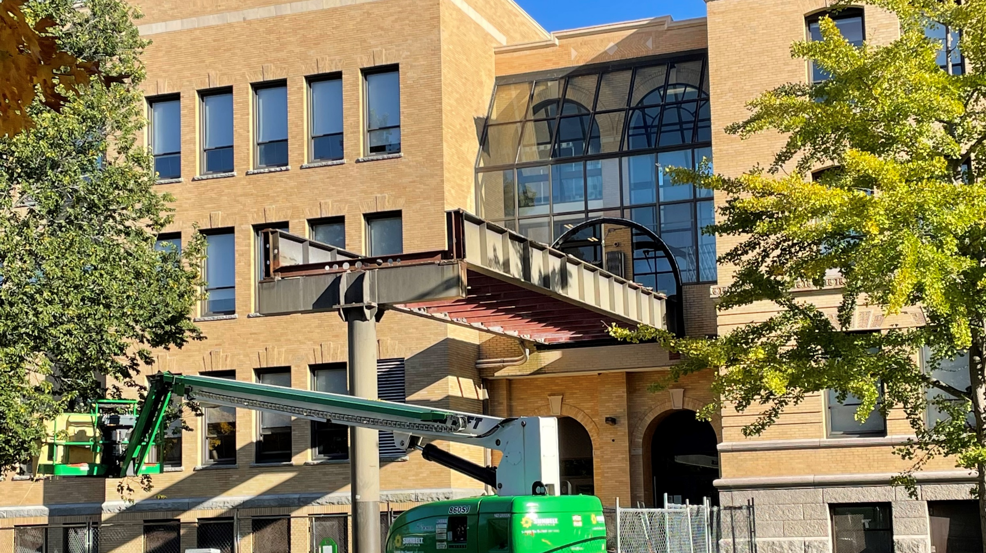
South Bridge Remain.

Slide 12
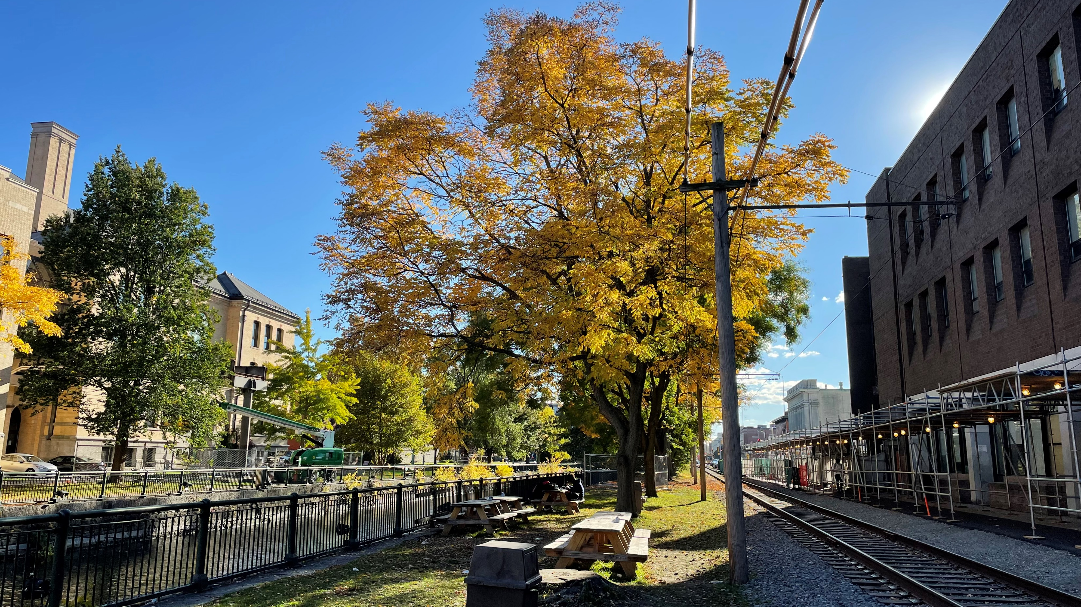
South Bridge Removal (after)

Slide 13
Part 3: MBE/WBE and Workforce Progress

Slide 14
MBE/WBE and Workforce Participation Comparison*
Total Construction
Minority Workforce
is at 24.9% of workers
(344 workers & 45,536 hours)
Total MBE/WBE Contracts Awarded
$21,617,266
Total Construction
Female Workforce
is at 3.6% of all workers,
(55 workers & 6,658 hours)
Total Construction Lowell Resident
10.7% of all workers
(78 workers & 19,573 hours)
*Updated August 11, 2022

Slide 15
Part 4: Designer Update

Slide 16

LEED Update
Notes:
Lowell High School project is targeting LEED Gold using the LEED v 4 checklist. LEED credits are earned based on the project’s design and construction activities. At the last SBC meeting, there were questions about our LEED status so I thought that I would update you this evening on some construction activities related to LEED credits.

Slide 17

89%
103+
average Construction waste diversion
Products with environmental product declarations (ePDs)
87.6-95.7%
77+
Total Recycled content of typically steel members
Products with 3rd party verification (ex. Declare label)
LEED BY THE NUMBERS
Notes:
To date, at 89%, we are exceeding the LEED minimum of 75% of waste diverted
This project includes several material with recycled content. One of the highest % of recycled content is our steel. % various by steel shape/type but of major elements, here is % recycled
Like the food we eat, we want to understand what ingredients are using within products. We learn the ingredients through EPDs. We exceed the 20 product minimum for LEED.
3rd party verification is more transparency

Slide 18
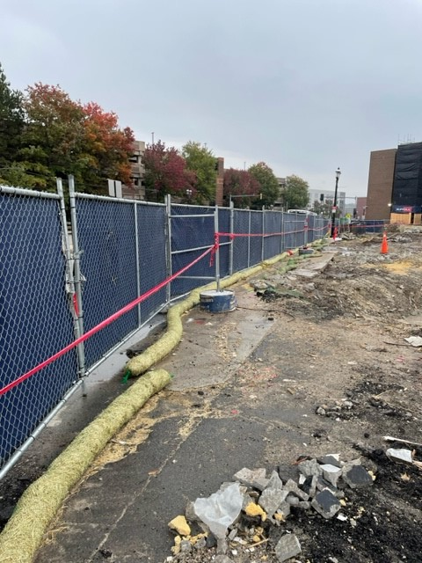
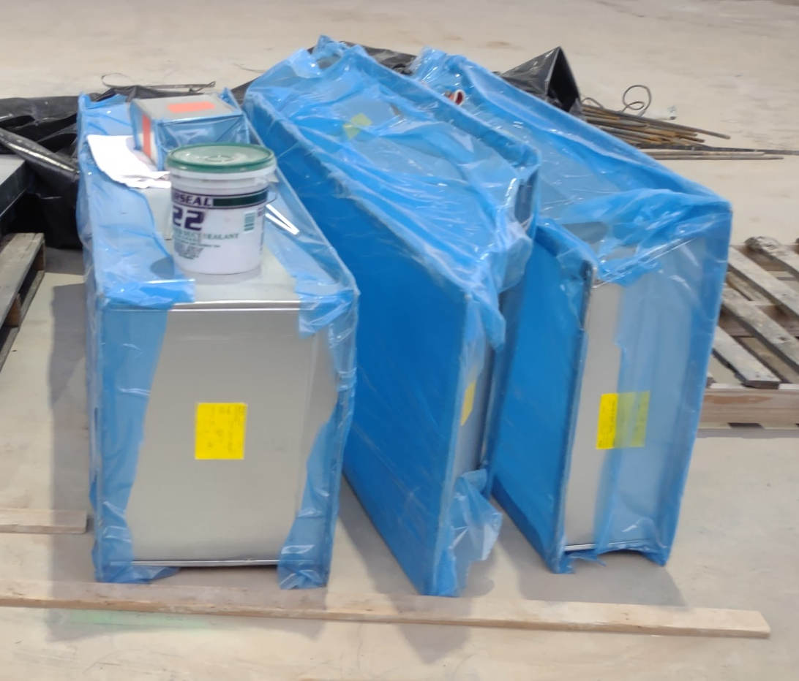

HVAC Air flushing
Construction indoor air quality
Erosion control
LEED DOUCMENTATION
Notes:
We are improving the indoor air in the building during and after construction a few ways.
Suffolk keeps all open ends of ductwork sealed until it is attached to other materials.
At the end of each phase, Suffolk is doing a HVAC air flushing of each phase. After the flush, they changed all air filters.
Outside of the construction area, Cashins is performing air quality testing on a monthly basis.
With sensitive to the adjacent canals and storm water infits, Suffolk has installed straw bails for erosion control along the perimeter of the site. Bails are replaced as needed.

Slide 19
Part 5: Budget

Slide 20
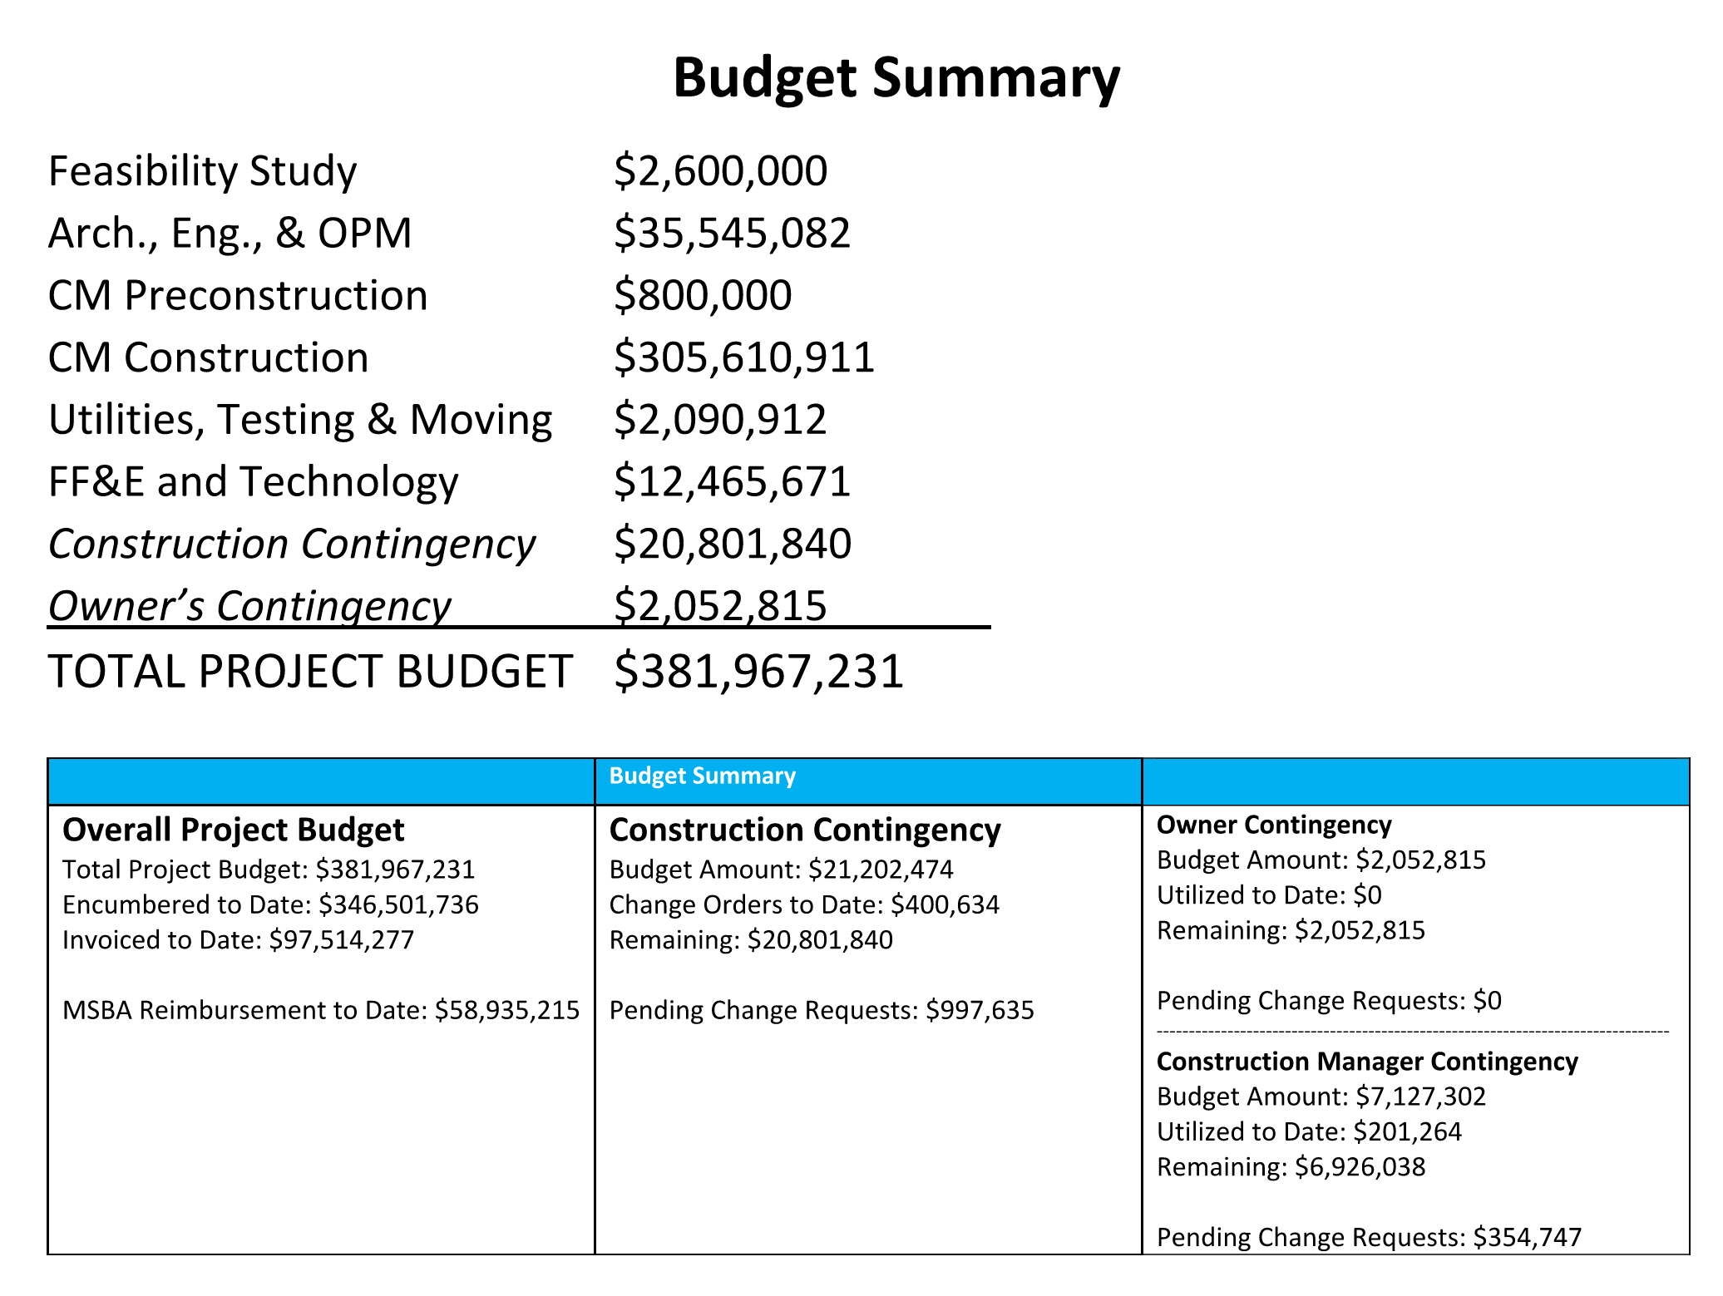

Slide 21
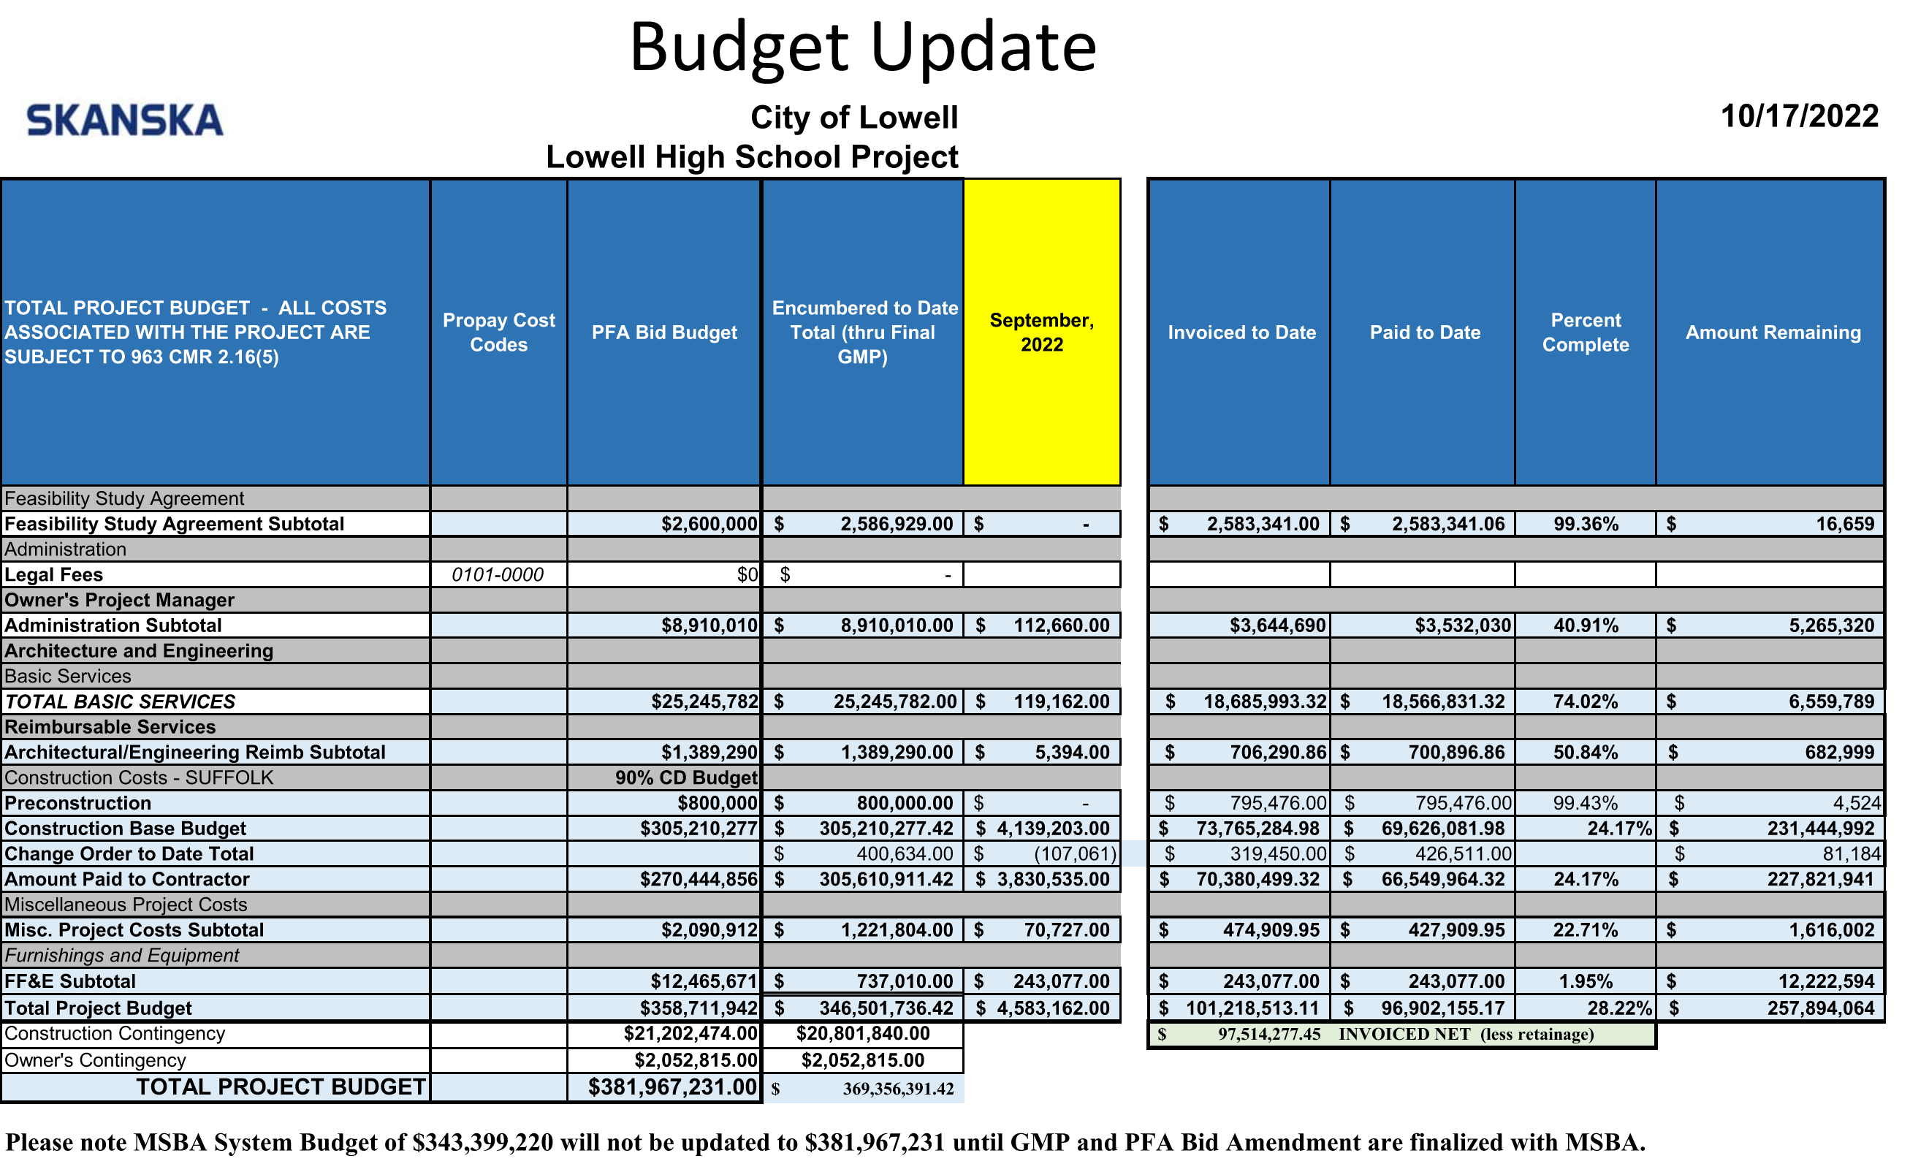

Slide 22
Part 6: Next Steps

Slide 23
Thank you

