Slide 1
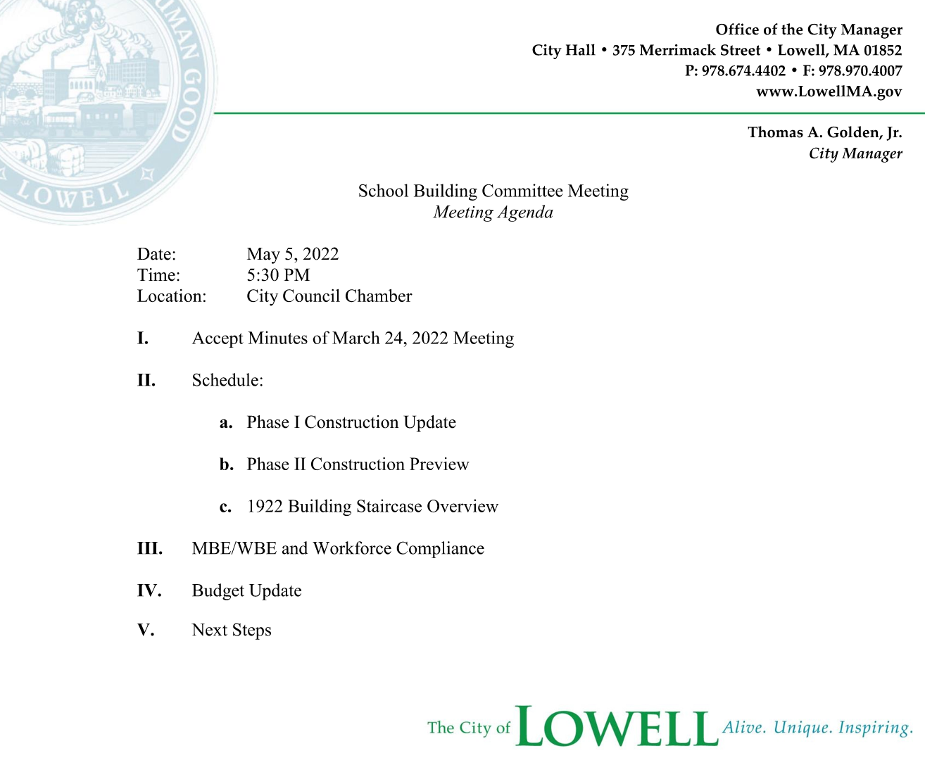
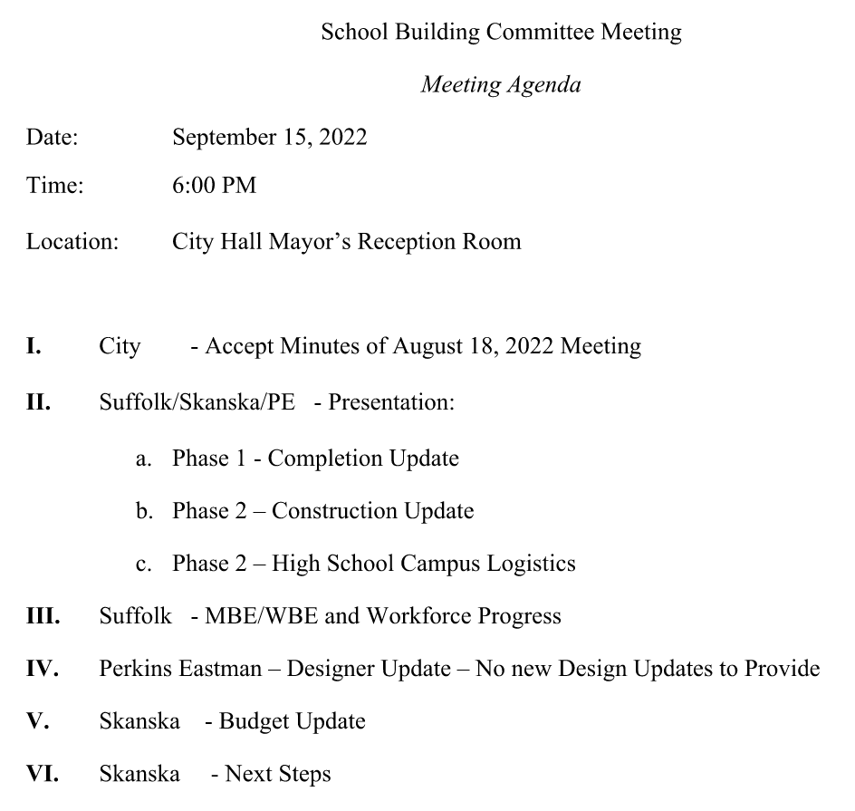

Slide 2
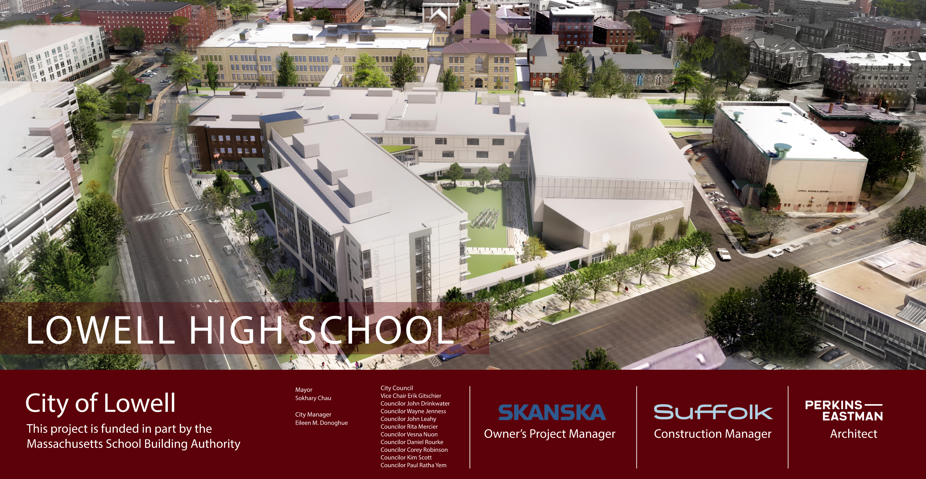

Project Overview
City Manager
Thomas A. Golden, Jr.

Slide 3
Construction Update

Slide 4
Phase 1 Construction Update

Slide 5
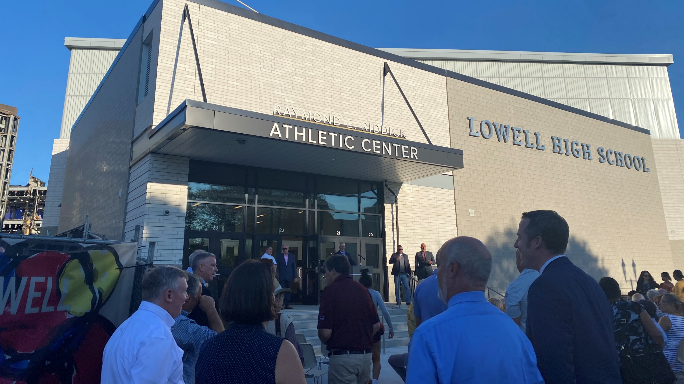
Remaining Phase 1 Activities
Finish Bleacher Installation
Place Loading Dock Concrete Pad
Final Paving
Fall Plantings
Complete “Punchlist”

Slide 6
Phase 2 Construction Update

Slide 7
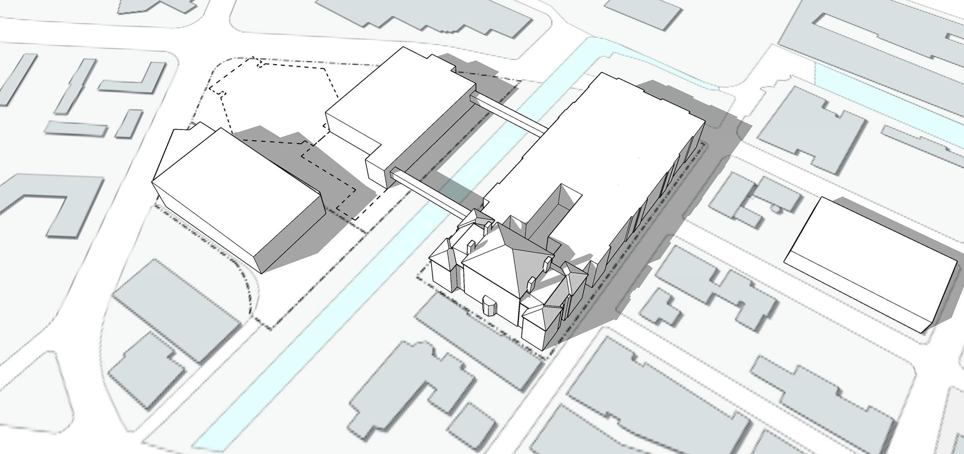

FALL ‘ 22
Phase 2 Milestones
September 2022
Continue Bulk Demolition
Continue Debris Load-out
Take down Field House
^{F}ATHER MORISSETTE BLVD
DEMO EXISTING GYMNASIUM
CONSTRUCTION
FENCE
TEMPORARY
MAIN ENTRY
EXISTING 1980 BUILDING
October 2022
Mobilize Sitework Contractor
Demo Existing Foundation
Remove South Bridge
Begin Pre-excavation
Begin Ground improvements
EXISTING 1922 BUILDING
FRENCH STREET
COMPLETED NEW GYMNASIUM BUILDING
ARCAND DRIVE
DEMO S. BRIDGE
EXISTING FRESHMAN ACADEMY BUILDING
DEMO PORTION OF EXISTING 1980 BUILDING
November 2022
Mobilize Concrete Contractor
Excavate Foundations
Form & Pour Concrete Foundations
Install Infiltration System
PAIGE STREET
KIRK STREET
CK CANAL
LEE STREET
IMA
_{R}R _{M}E

Slide 8
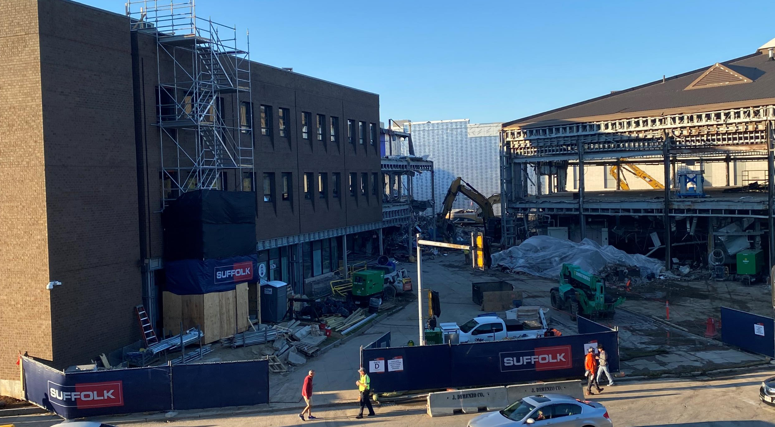
Demo Activities from Father Morissette

Slide 9
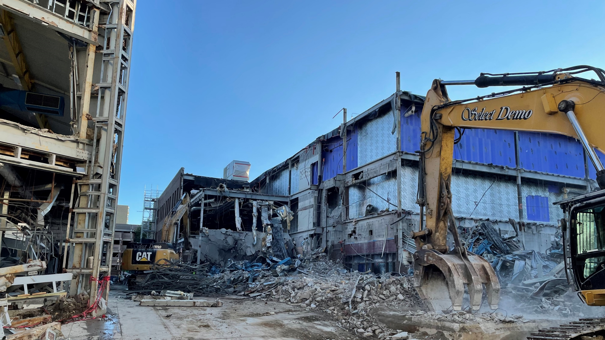
Take-down 1980’s Building South End

Slide 10
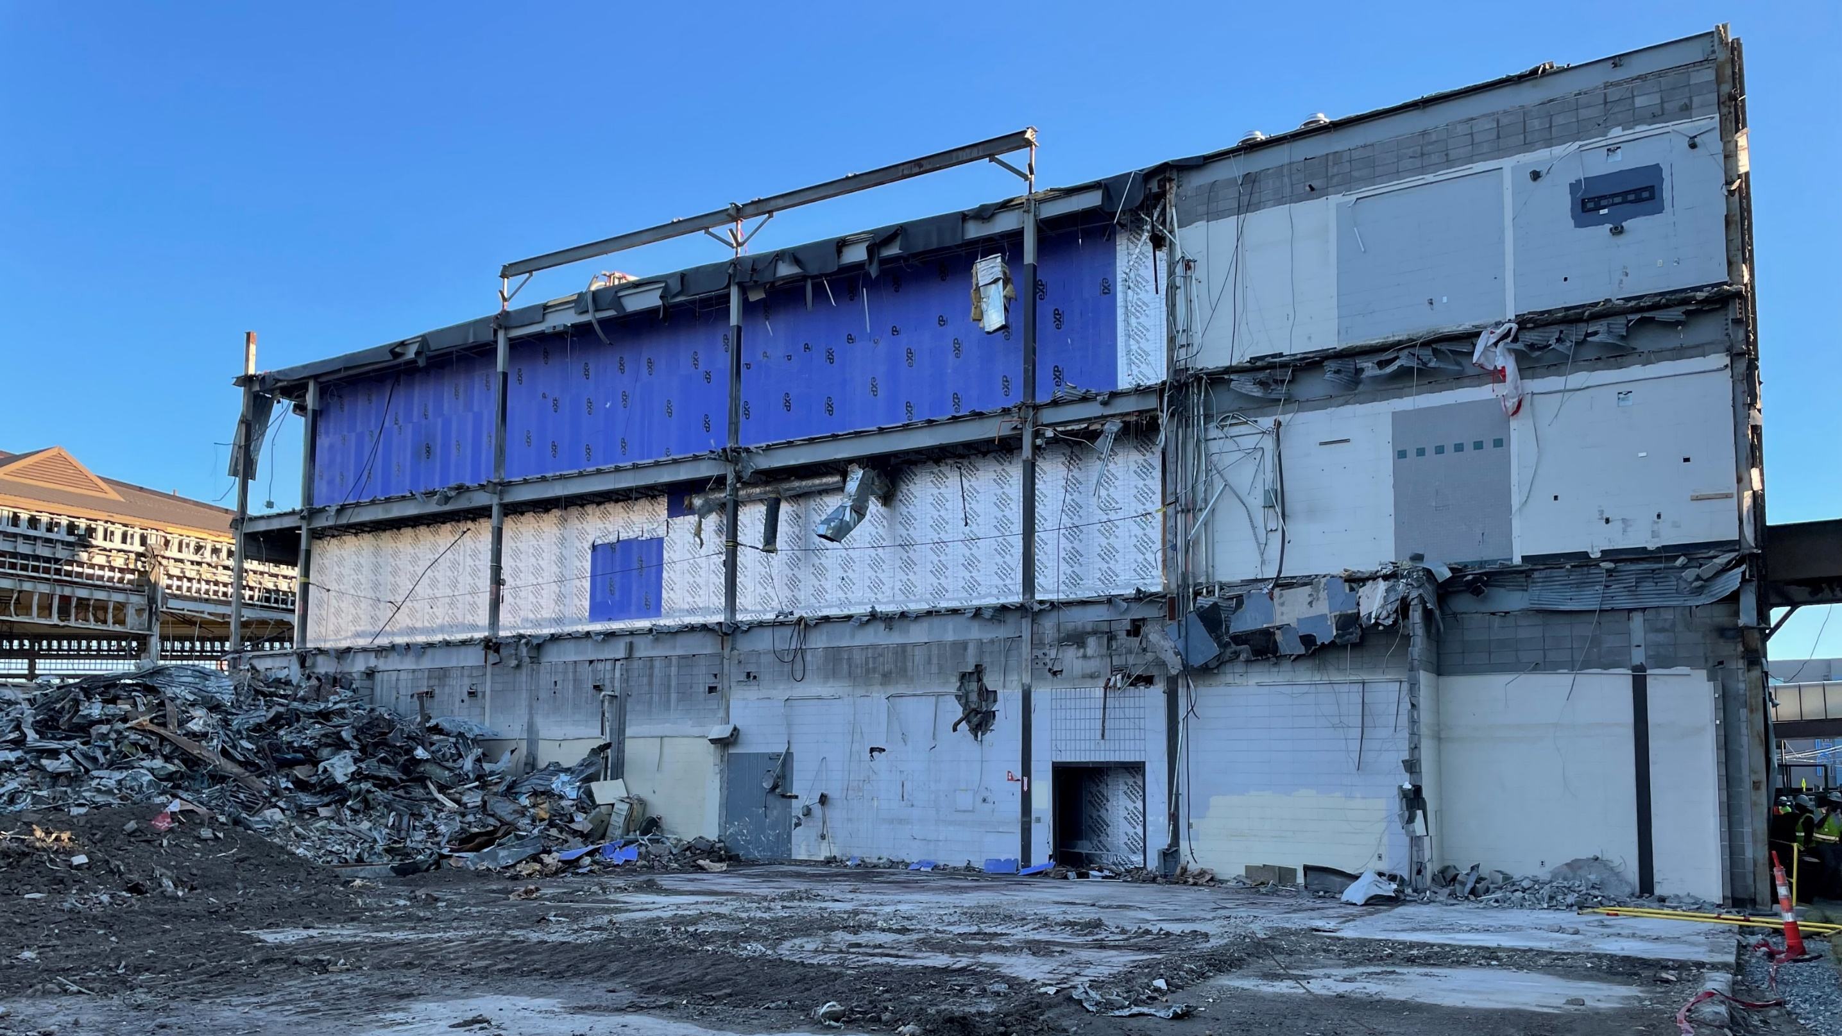
1980’s Building South End

Slide 11
High School Campus Logistics

Slide 12
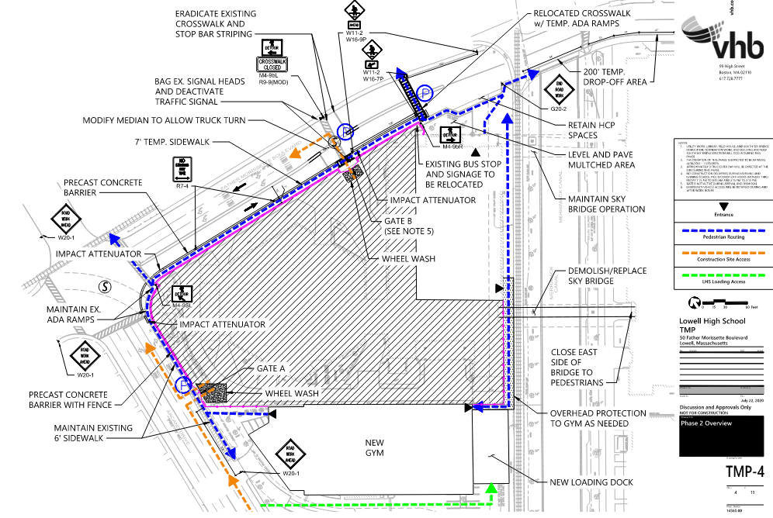
Phase 2 – Traffic Management Plan

Slide 13
Part 3: MBE/WBE and Workforce Progress

Slide 14
MBE/WBE and Workforce Participation Comparison*
Total Construction
Minority Workforce
is at 25.1% of workers (313 workers & 42,477 hours)
Total MBE/WBE Contracts Awarded
$21,617,266
Total Construction
Female Workforce
is at 3.6% of all workers, (47 workers & 6,028 hours)
Total Construction Lowell Resident
10.7% of all workers (73 workers & 18,059 hours)
*Updated August 11, 2022

Slide 15
Part 4: Designer Update

Slide 16
Part 5: Budget

Slide 17
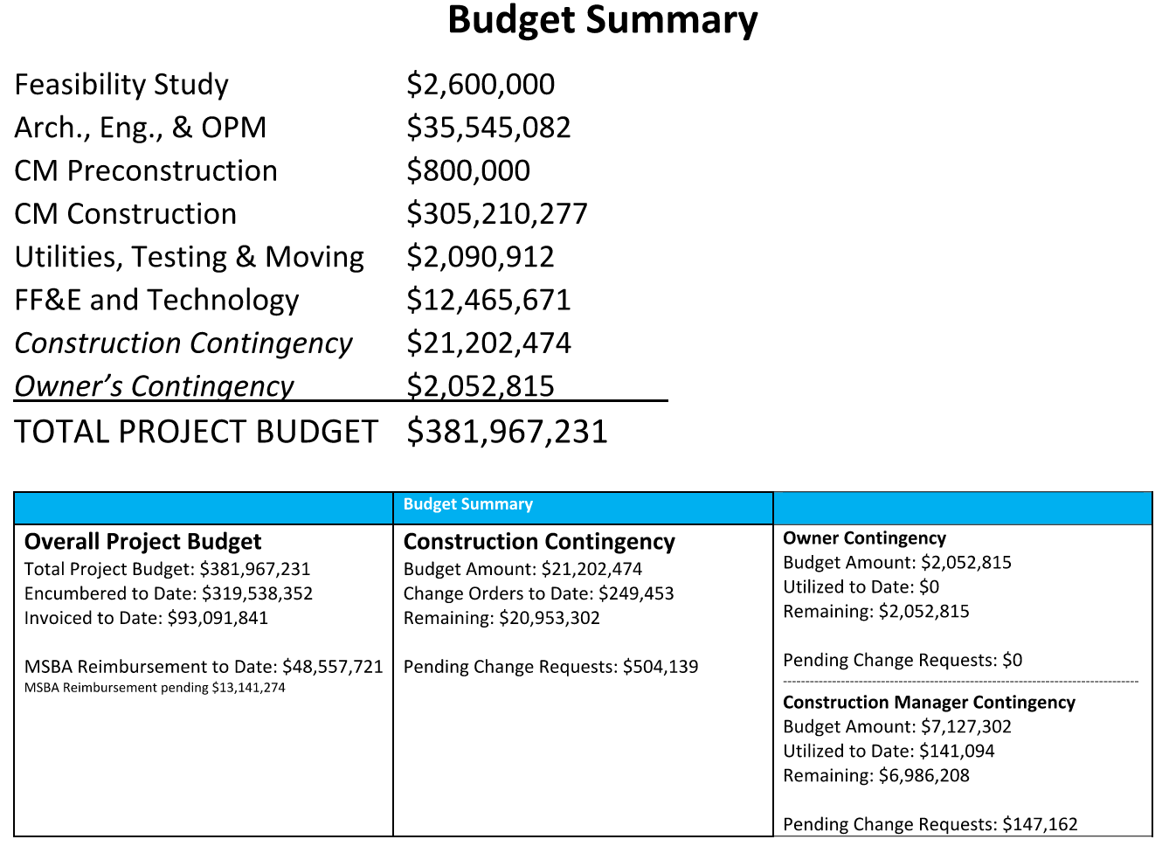

Slide 18
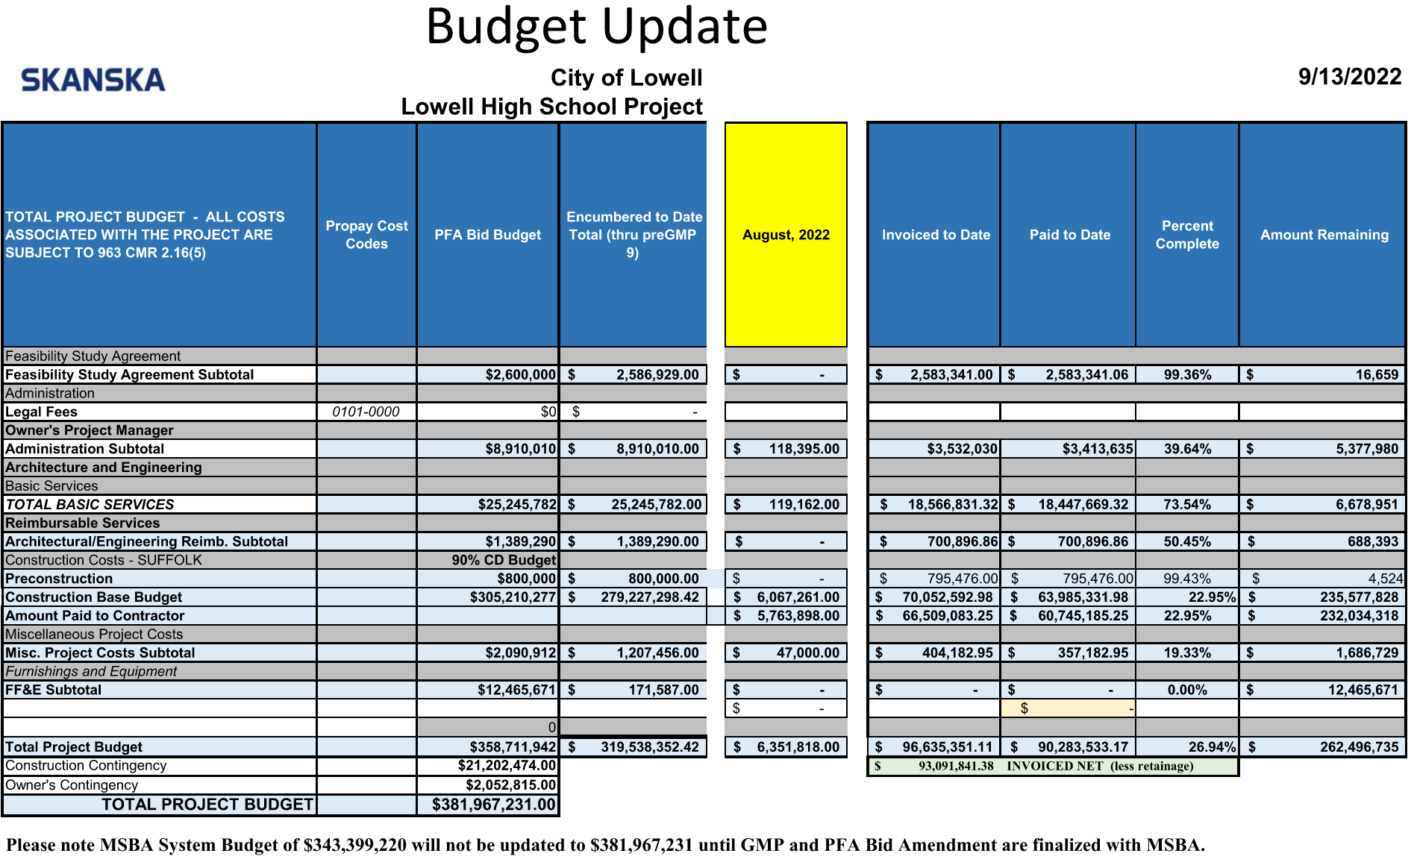

Slide 19
Part 6: Next Steps

Slide 20
Thank you

